Slide 1
The Assessment
Press the spacebar to continue
Notes:
Each element and sub-element sections are designed the same way
Fields will grow as you type
Type in between the bracket

Slide 2
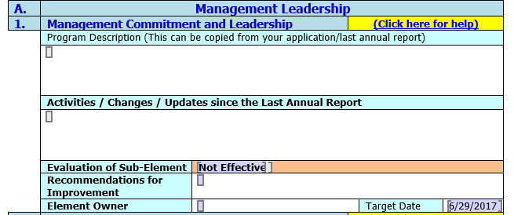
The Assessment
Each element and sub-element sections are designed the same way
Fields will grow as you type
Type in between the bracket
Element Name
Link for help
Brief overview of the element
Any updates since the last annual report was submitted
Press the spacebar to continue
Notes:
Each element and sub-element sections are designed the same way
Fields will grow as you type
Type in between the bracket

Slide 3
The Assessment
Don’t forget the “Click here for help” link for more information on each element
Add any recommendation to improve
Use drop down to select
Name or committee who is responsible for this element
Enter Target Date (this is a date picker field)
Press the spacebar to continue
Notes:
Don’t forget the “Click here for help” link for more information on each element as a reference!

Slide 4
General Element Suggestions
Read the Information for Conducting a Good Self Evaluation in the Appendix
Have multiple employees involved in the evaluation
Discuss increases/decreases in data that you collect for safety and health performance indicators, (I.e. completion of required actions, involvement of employees, etc.)
What trends have you discovered?
What programs need attention?
Press the spacebar to complete
Notes:
Read the Information for Conducting a Good Self Evaluation in the Appendix
Have multiple employees involved in the evaluation
Use numbers – how many near misses were turned in? Is that an increase or decrease from the previous years?
What trends have you discovered?
What programs need attention?

