Slide 1
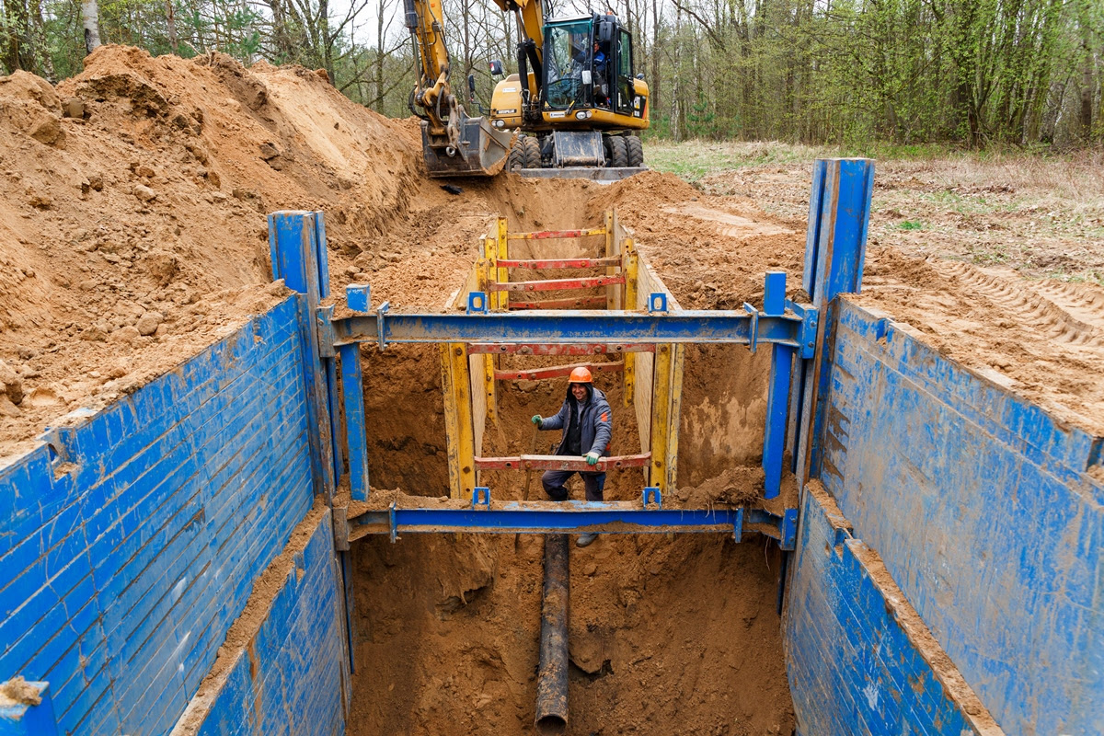
Trenching and Excavation
VOSH Consultation Services

Slide 2
Prevention is Life Saving
Excavation and Trenching are among the most hazardous construction operations. On average 25 people die each year in trenching incidents, many more seriously injured. Dirt is heavy. One cubic yard equals about 3,000 pounds or more, about the same as a mid-sized car! A person trapped in a cave-in, has little chance for survival.

Slide 3
What is a Trench vs Excavation
Trench: a narrow excavation made below the surface of the ground. In general, the depth of a trench is greater than the width (measured at the bottom) is not greater than 15 feet.
Excavation: any man-made cut, cavity, trench or depression in the earth’s surface formed by earth removal.

Slide 4
Hazards
Cave-ins or collapses that can trap workers
Equipment or excavated soil falling on workers Falling into the trench or excavation
Flooding or water accumulation
Exposure to a hazardous atmosphere (e.g., gas, vapor, dust, or lack of oxygen)
Contact with buried service lines such as electrical, natural gas, water, sewage, telecommunications, etc.
Contact with overhead electrical lines
Slips, trips and falls as workers climb on and off equipment, or from inappropriate access and egress methods

Slide 5
How to Stay Safe
Ensure that there's a safe way to enter and exit
Ensure trenches have cave-in protection
Look for standing water and test for atmospheric hazards
Keep materials away from the edges of the trench
Never enter a trench that has not been inspected by a competent person

Slide 6
Safe Entry and Exit
Employers are responsible for providing ladders, stairways ramps or other ways to ensure safe egress. In hazardous circumstances employee survival could depend on how quickly they can escape from a trench or excavation.

Slide 7
How To Ensure Safe Egress
Provide stairways, ladders, ramps, or other safe means of egress in all trenches that are 4 feet deep or more.
Means of egress need to be within 25 lateral feet of workers.
Ensure means of entering and exiting the trench is within the protective system.
Structural ramps must be designed by a competent person and have a non-slip surface.

Slide 8
Cave-In Protection
Trenches and excavations are extremely hazardous due to the fact that soil is often unstable. If workers are working in trenches or excavations that are five feet or greater they are required to have cave-in protection.

Slide 9
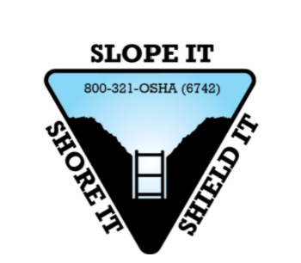
Types of Protection
There are three types of cave-in protection
Sloping
Shoring
Shielding systems

Slide 10
Sloping
Sloping is when you cut away the trench wall at an angle to prevent cave-ins. The angle of your slope will be determined by the soil type.

Slide 11
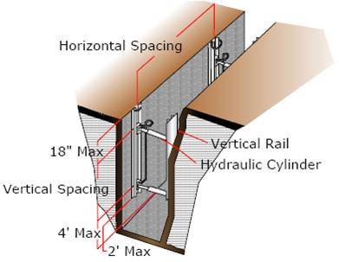
Shoring
Shoring is a structure such as a metal hydraulic, mechanical or timber system that supports the sides of an excavation and is designed to prevent cave-ins.
Source of photo: osha.gov

Slide 12
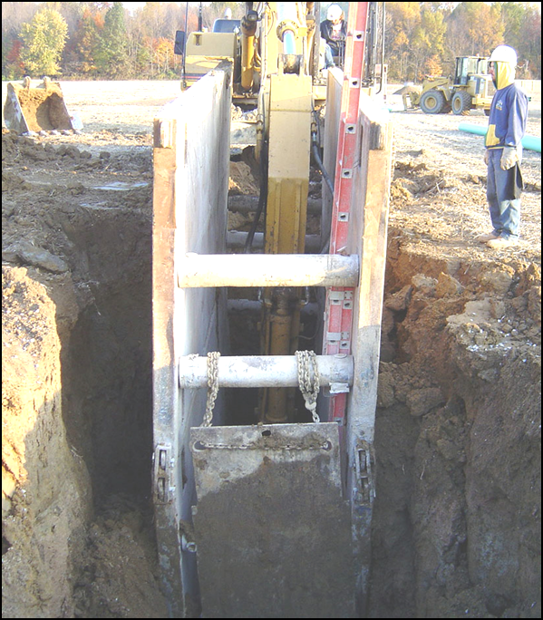
Shields
Shields, often called trench boxes, are structures that are able to withstand the forces of a cave-in and thereby protect employees within the structure. For Shields to be effective workers must stay inside them at all times.
Source of photo: osha.gov

Slide 13
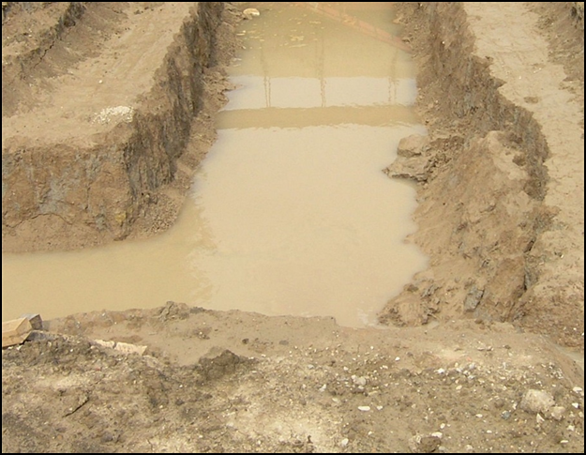
Standing Water and Atmospheric Hazards
Excavations may present risks of hazardous atmosphere and water accumulation. If any of these conditions exist, workers could be exposed to the possibility of suffocating, inhaling toxic materials, being burned or engulfed by fire, or drowning.
Source of photo: osha.gov

Slide 14
To ensure employee safety when water accumulates or there is a hazardous atmosphere, inspections should be performed by a competent person
Before construction begins
Daily before each shift
As needed throughout the shift
Following rainstorms or other hazard-increasing events (such as a vehicle or other equipment approaching the edge of an excavation)

Slide 15
Hazardous Atmospheres
When working in trenches or excavations with hazardous atmospheres (e.g., gas, vapor, dust, or lack of oxygen), atmosphere sampling needs to be performed before workers enter the excavation as often as necessary to ensure that the atmosphere remains safe

Slide 16
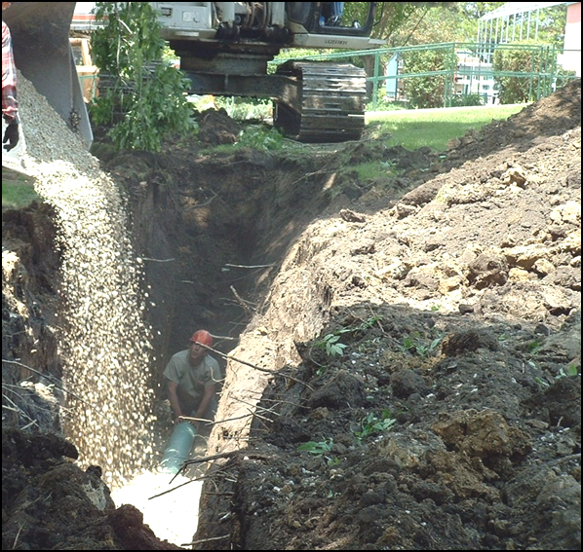
Keep Materials Away from the Edge of the Trench
Excavated material (spoils) at your site are hazardous if they are set too close to the edge of a trench/excavation.
The weight of the spoils can cause a cave-in, or spoils and equipment can roll back on top of workers, causing serious injuries or death.

Slide 17
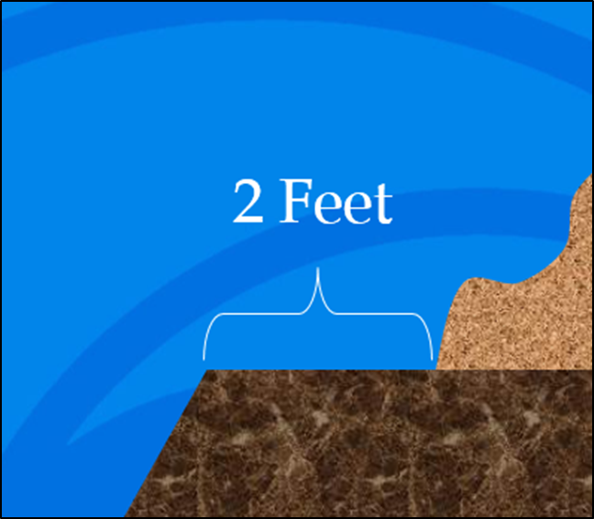
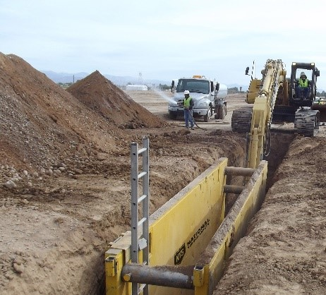
Keep Materials Away from the Edge of the Trench
Set spoils and equipment at least two feet back from an adequately protected excavation.
Use retaining devices, such as a trench box that will extend above the top of the trench to prevent equipment and spoils from falling back into the excavation.
Where the site does not permit a two-foot setback, spoils may need to be temporarily hauled to another location.

Slide 18
Inspections
The conditions of an excavation can change during the course of work. Even a properly protected excavation or trench can become compromised.
Employers can help ensure that excavations are safe to work in by directing a competent person to inspect excavations:
Before construction begins
Daily before each shift
As needed throughout the shift
Following rainstorms or other hazard-increasing events (such as a vehicle or other equipment approaching the edge of an excavation)

Slide 19
Inspections
Inspections must be conducted by a competent person.
OSHA defines a “competent person” as “one who is capable of identifying existing and predictable hazards in the surroundings, or working conditions which are unsanitary, hazardous, or dangerous to employees, and who has authorization to take prompt corrective measures to eliminate them.”
"competent person"
Has training in the use of protective systems.
Is knowledgeable about OSHA requirements.
Has authority to immediately evacuate workers from the excavation and ensure that hazardous conditions are addressed.

Slide 20
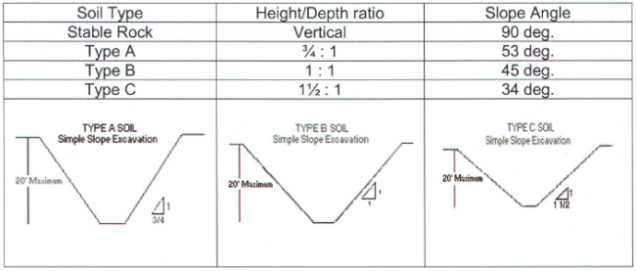
Soil Classification
OSHA Standards soil classifications consists of four categories. Stability is greatest in stable rock and decreases through type A and B to type C. Type C is the least stable!
Stable Rock
Type A Soil
Type B Soil
Type C Soil

Slide 21
Soil Classification
Stable Rock: is defined as natural solid mineral that can be excavated with vertical sides and remain intact while exposed.
(Examples: granite or sandstone)
Type A Soil: are cohesive with high unconfined compressive strength; 1.5 tons per square foot or greater. Soil can not be classified as type A if it is fissured, if it has been previously disturbed, if it has water seeping through it, or if it is subject to vibration from sources such as heavy traffic or pile drivers.
(Examples: clay, silty clay, sandy clay, and clay loam)

Slide 22
Soil Classification
Type B Soil: is cohesive and has often been cracked or disturbed, with pieces that don't stick together as well as Type A soil. Type B soil has medium unconfined compressive strength; between 0.5 and 1.5 tons per square foot.
(Examples: angular gravel, silt, silt loam, and soils that are fissured or near sources of vibration, but could otherwise be Type A)

Slide 23
Soil Classification
Type C Soil: is the least stable type of soil. Type C includes granular soils in which particles don't stick together and cohesive soils with a low unconfined compressive strength; 0.5 tons per square foot or less.
(Examples: gravel, sand and loamy sand. Because it is not stable, soil with water seeping through it is also automatically classified as Type C soil, regardless of its other characteristics.

Slide 24
Soil Test & Identification
Before testing the soil, it's useful to perform a visual test of the construction site. This will help determine if there are factors on site that will lower the strength of the soil. There are many kinds of equipment and methods used to determine the type of soil in an area, often multiple methods are needed:
Visual Test: If the excavated soil is in clumps, it is cohesive. If it breaks up easily, it is granular.
Pocket Penetrometer: Penetrometers are direct reading, spring operated instruments used to determine the unconfined compressive strength of saturated cohesive soils.

Slide 25
Soil Test & Identification
Thumb Penetration Test: The thumb penetration procedure involves an attempt to press the thumb firmly into the soil in question. If the thumb makes an indentation in the soil only with great difficulty, the soil is probably type A. If the thumb penetrates no further than the length of the thumb nail, it is probably type B. If the thumb penetrates the full length of the thumb it is type C.
Wet Manual Test: Wet your fingers and work the soil between them. Clay is a slick paste when wet, meaning it is cohesive. If the clump falls a part in grains it is granular.

Slide 26
Other Hazards
Locate all unground utilities before digging.
Underground installations must be protected, supported or removed when excavation is open.
Never allow workers outside of protected areas in a trench. Sloped, Shored or Shielded Areas.
Never allow workers to be under raised loads.

Slide 27
Websites to Know
VOSH Free Consultation:
https://www.doli.virginia.gov/vosh-programs/consultation/
Trenching and Excavation Resources:
https://www.osha.gov/vtools/construction/soil-testing-fnl-eng-web
https://www.osha.gov/vtools/construction/trench-fnl-eng-web
https://www.nsc.org/workplace/safety-topics/work-to-zero/hazardous-situations/excavation
https://www.cdc.gov/niosh/topics/trenching/
https://www.cpwr.com/wp-content/uploads/publications/TT-Trenches.pdf
https://www.cpwr.com/wp-content/uploads/2020/06/SS2019-Trenching-Fatalities-Causes-and-Reduction.pdf
https://www.assp.org/news-and-articles/2018/08/14/keeping-workers-safe-during-trenching-and-excavation
https://www.iup.edu/pa-oshaconsultation/focal-points/trenching-and-excavations/

Slide 28
VOSH Regional Offices

